Slide 1

AGB1211 – DESIGN THINKING
Department of Artificial Intelligence and Data Science
Academic Year: 2024 – 2025 (Odd Semester)
Year : II
Semester : III
Section : B
Date : 6-12-2024
PRESENTED BY, GUIDED BY
1. MITHRAVASAN V B H(2303811724321065) JOANY FRANKLIN M.E.,
2.MOHAMED ADHIL AMEEN R(2303811724321066) Assistant Professor,
3.MOHAMED FIRDOUS S(2303811724321067) Department of AI,
4. MOHAMED IBRAHIM F(2303811724321068) K.Ramakrishnan College of Technology.

Slide 2
Title of the Project
MENTAL HEALTHCARE SYSTEM

Slide 3
Problem Identification
Rising Cases of Mental Health Issues: Increasing prevalence of mental health problems such as anxiety, depression, and stress due to lifestyle changes and societal pressures.
Stigma and Social Barriers: Persistent stigma around mental health prevents individuals from seeking timely help.
Limited Accessibility to Professional Care: Insufficient availability of affordable and accessible mental health professionals and facilities, particularly in rural and semi-urban areas.
Lack of Real-Time Monitoring and Support: Absence of systems to provide continuous mental health monitoring and personalized support.

Slide 4
Objective
The AI-powered mental healthcare system aims to provide accessible, personalized, and scalable mental health solutions. It integrates advanced AI technologies for early detection, real-time monitoring, and intervention of mental health conditions. Designed for diverse user needs, it offers a cost-effective platform with features like virtual therapy, self-help tools, and community engagement. Integrated with a mobile app, the system ensures remote accessibility, continuous mental health tracking, and stigma-free support for individuals in both urban and rural areas.

Slide 5
BrainStorming
AI-based Prediction
Real-time Monitoring
Mental Health Assessment Tools
Advanced TherapyOptions
Community Engagement
Eco-friendly Solutions
User-friendly Dashboard
Automation Integration

Slide 6
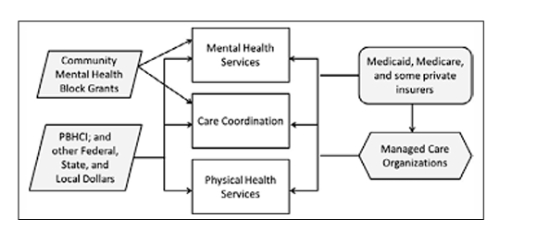
Mind Map

Slide 7
Primary Research
→Surveys and Questionnaires: Conduct surveys among individuals, families, and caregivers to understand their awareness, attitudes, and challenges related to mental health.
→Interviews: Interview mental health professionals, counselors, and psychologists to identify common issues and potential gaps in existing mental health services..
→Field Observations: Visit mental health clinics, counseling centers, and community support groups to observe current workflows, accessibility, and areas needing improvement.
→User Testing: Test prototypes of the mobile app or mental health system features with potential users, including patients, caregivers, and mental health practitioners.

Slide 8
Secondary Research
→Research Papers and Articles: Review academic papers, journals, and articles on mental health challenges, AI integration in healthcare, and digital solutions for mental health management.
→Government and NGO Reports: Study reports on mental health policies, prevalence statistics, and initiatives by governments and NGOs to address mental health issues.
→Case Studies: Examine case studies of mental health systems or apps that have successfully improved mental well-being in specific communities or demographics.
→Market Research: Investigate trends in the mental healthcare industry, including emerging technologies, popular mental health apps, and AI-based solutions.

Slide 9
Proposed Work
Mental Health Monitoring: Integrated sensors assess mental health patterns, ensuring timely detection and intervention.
Mobile App Integration: A user-friendly app provides live updates, mental health tips, usage data, and system performance insights via mobile.
Therapy Session Reminders: Automated alerts ensure timely scheduling and attendance of therapy sessions.
Mood Tracking and Management: Smart sensors track mood variations and suggest coping strategies when changes are detected.

Slide 10
List of Modules
AI for Mental Health Analysis
IoT for Mental Health Monitoring.
Mobile App

Slide 11
AI for Mental Healthcare System
Content:
Uses AI to detect mental health patterns and predict potential issues with high accuracy.
Enhances early intervention and personalized care strategies.
Provides real-time notifications and actionable insights to users.

Slide 12
IOT Monitoring
Content:
Tracks physiological and psychological health metrics in real time.
Automatically identifies irregular patterns and potential mental health concerns.
Sends alerts for necessary interventions or therapy sessions.

Slide 13
Mobile App
Content :
Provides remote monitoring and insights into mental health metrics.
Tracks historical data on mood patterns and behavioral trends.
Sends reminders for therapy sessions and personalized mental health tips.

Slide 14

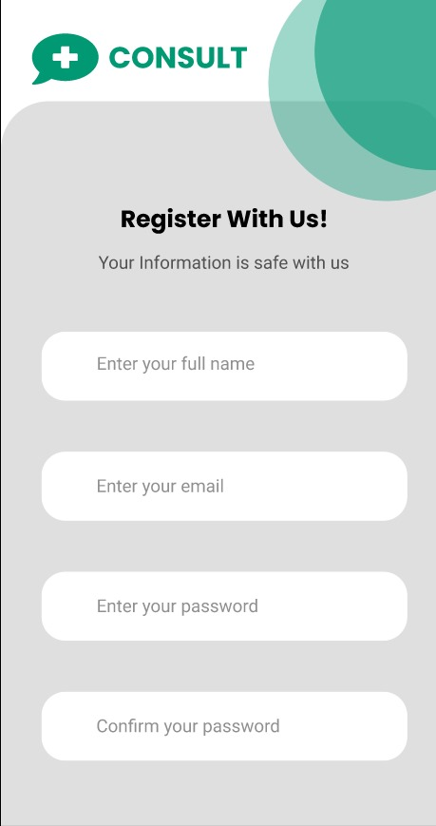
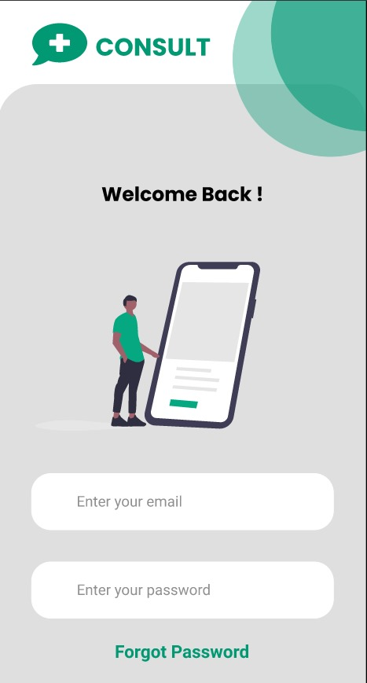
Results

Slide 15
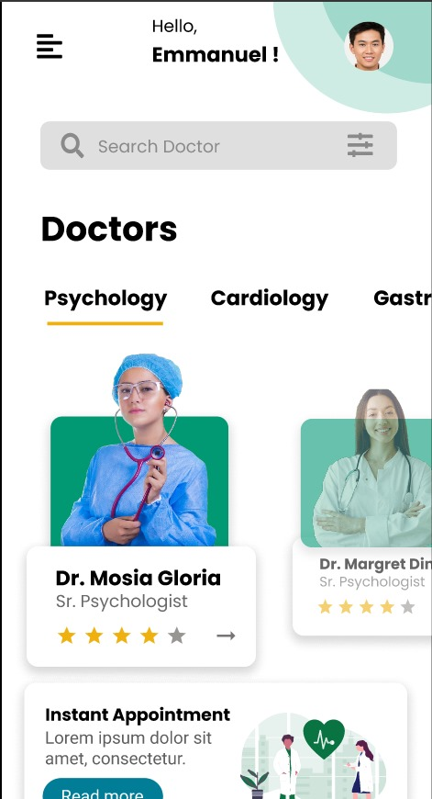
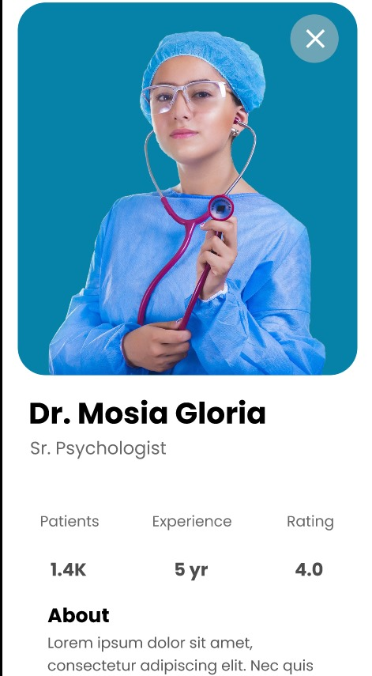
Results

Slide 16
Conclusion
The proposed mental healthcare system leverages advanced technologies to ensure efficient monitoring, early detection, and personalized care. Its modular and user-friendly design supports mental well-being by providing timely interventions, actionable insights, and accessible support for diverse user needs.

Slide 17
Thank You
Any queries???

